Slide 1

Awoo Corporation
Promo Presentation
Our Wonderful Products
and why you should
BUY THEM!!!

Slide 2
Awoo Corporation
Promo Presentation
Diverse Products
Item Name | Description | Price | Product ID
The Howler 3000 | Automatically howl at moon. | 35,00 грн. | 710527
Awoo Statue | It's a stone wolf! | 150,00 грн. | 504875
Medio80 | Wonderful PC from PrimePC. | 240,00 грн. | 838316
Prodigy | Lua interpreter by a wolf | 5,00 грн. | 187807
CTF3FITA | Chip that flies 3ft into the air. | 15,00 грн. | 563260
Wolfium | 100% pure wolf block. | 69,00 грн. | 56136
Super Growl Machine | It growls at your opponents. | 53,00 грн. | 496807
Fang | Just a replaceable fang. | 17,00 грн. | 968606
Claw | Just a replaceable claw. | 16,00 грн. | 329487
Tail | Not for sale hehe. | - | 794767
Wolf to USB adapter | Plug your wolf into a PC. | 130,00 грн. | 444805
We hope you enjoy our wide product production. Awoo Corporation offers many fun and productive products for the liking of all. Please familiarize yourself with our offerings on the left !!

Slide 3
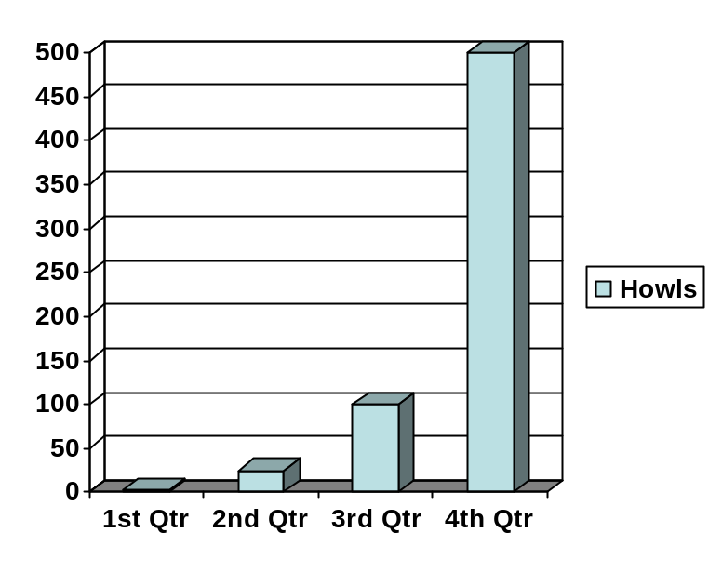
Awoo Corporation
Promo Presentation
Successful
The Awoo Corporation is doing absolutely great economically and we are thriving very much thank you. I hope you can trust us with all your business. Awoooooooooooooooooooooooooooooooooooooooooooooooooooooooooooooooooooooooooooooooooooo.
Success
Us!!
Howling
Growling

Slide 4
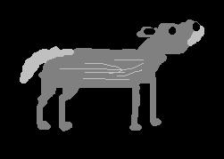
Awoo Corporation
Promo Presentation
FUN AND COOL
Wolves have been scientifically proven to be very cool and awesome and exciting and fierce and bitey. It is preferable that you do not try to pat one, however a wolf might try to pat you.

Slide 5

Awoo Corporation
Promo Presentation
coolest slide
wOLF
OTHERS
BEST SLIDE EVER
EVER
OTHERS OTHERS
wolf
AWOO!!!

Slide 6
Awoo Corporation
Promo Presentation
Thanks
for paying attention!!!!!!!!!!!!
Us!!

